Slide 1
GESIS Leibniz Institute for the Social Sciences
Harmonizing survey data across different survey modes
Dr. Ranjit K. Singh (ranjit.singh@gesis.org)
ESS & NatCen Survey Methodology Seminar 2022-10-19

Slide 2
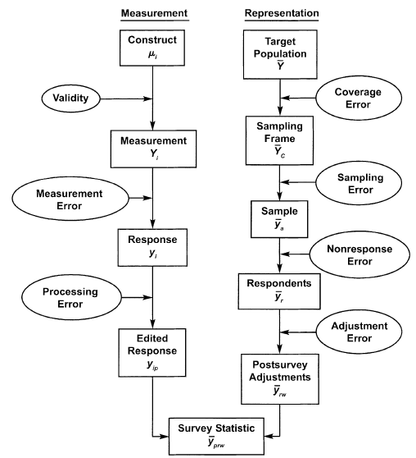


Total Survey Error: The smaller, the better!
Measurement
Representation
$$τ$$
3
Groves et al., 2009
Notes:
Let us start out with the familiar total survey error framework to assess and improve survey quality.
Here we see that errors can be divided into representation errors and measurement errors.
Representation errors focus on the population and describe ways in which our survey data may misrepresent it.
Measurement errors, meanwhile, focus on individuals and desribe ways in which scores in our data may misrepresent respondents true construct values.
To improve the quality of a survey, we want to reduce all errors as much as possible.

Slide 3
Survey Error(s): The more similar, the better!
Survey
Mode
A
Survey
Mode
B
Notes:
Now in comparability and harmonization, the goal is subtly different.
If we have two survey modes A and B, then we have to sets of survey errors.
And the goal becomes not a reduction of absolute errors, but instead to assess if the errors in both modes are similar.
Keep in mind that all slides going forward will take on this comparative perspective on errors.

Slide 4

Comparable Measurement
The Respondents with the same true score
should give the same response (on average), regardless of the survey mode.
3
$$τ$$
&
The same response score in our data
should allow the same inferences about the respondent,
regardless of the survey mode.
Notes:
This abstract idea implies the following two desirable properties of comparable measurements:
The same respondent should give the same response (on average), regardless of the survey mode.
The same response score in our data should allow the same inferences about the respondent, regardless of the survey mode.
Both points are, of course, two sides of the same coin.

Slide 5



Components of Comparability
3
A
A
3
B
B
Comparable…
Concepts
Reliability
Measurement
units
Systematic Error
Random error
Scaling
$$Δ$$
$$Δ$$
$$Δ$$
Notes:
These three components of comparability are less of a formal, statistical framework and more a heuristic I use when I counsel researchers on harmonization projects.
Still, it helps us divide comparability into familiar, important issues of measurement quality and comparability.
First are systematic errors. Here we ask if we capture the same substantive information in both survey modes.
Second are random errors. Here we ask if we measure whatever we measure with a similar level of precision in both survey modes.
Lastly are measurement units. Here we ask if the numerical scores in our datasets imply the same construct intensity in both survey modes.
For example, Does a three imply the same level of social trust in both modes?

Slide 6
Comparable Concepts
The first and most fundamental issue in comparability: Do we measure the same concept?
Between different survey modes, substantive differences in question understanding are unlikely.
However, survey modes may contaminate measurement with mode specific systematic errors
Examples:
More socially desirable responding when an Interviewer is present?
Greater respondent burden in one mode may intefere with memory retrieval
Notes:
Let us take a closer look at the first component: conceptual comparability.
It is fundamental for comparability that we measure the same concept.
This issue is very pressing in my work on survey question with different question wordings.
Between survey modes I would usually expect that the basic question understanding is similar across modes, unless the questions are very complicated.
However, this still leaves the issue of other sources of systematic errors that may contaminate our measurement and lead to different biases and methodological artifacts in the different survey modes.
For example: What if survey modes with interviewers induce more socially desirable responding than self-completion modes?

Slide 7
Comparable reliabilities
Random error is non-systematic error variance Reliability is the other side of the same coin
Attenuation The less reliable our measurement, the lower are correlations in our analyses
If survey modes lead to different reliabilities, substantive correlations are spuriously lower in one mode than the other
Example:
A survey switches its mode. The new mode leads to higher random error and thus lower reliability. Now we find that political interest suddenly predicts political participation less after the mode switch. A methodological artifact due to attenuation!
Notes:
Next, the issue of comparabile reliabilities. Reliability is the inverse of random error. Random errors, meanwhile, are measurement errors that add non-systematic noise to our measurements.
They do not bias our measurements in a specific direction, but they reduce all correlative effects in our analyses throuh attenuation.
The less reliable a measurement, the lower are all correlations that involve that unreliable variable.
If survey modes differ in ther average reliability, we suddenly have spurious differences in our correlative analyses, such as regressions.

Slide 8
Comparable Measurement Units
Many survey questions capture a continuous concept in an ordinal (or pseudo-metric) measurement scheme
2
A
1
2
3
4
Very interested | Quite interested | Hardly interested | Not at all interested
Notes:
Lastly, the issue of comparable measurement units.
Many concepts we measure are continuous. Think of levels of political interest.
During measurement, we map these continous true scores onto an ordinal measurement scheme.
We can imagine this mapping process as cutting the continuum of true scores into segments with thresholds.
Up to the first thresholds, respondents most likely choose a 1.
Our example respondend is slightly less interested in politics and chooses a 2. And so on…

Slide 9
Comparable Measurement Units
Many survey questions capture a continuous concept in an ordinal (or pseudo-metric) measurement scheme
This mapping may change between different survey modes
2
A
1
1
2
3
4
B
Very interested | Quite interested | Hardly interested | Not at all interested
Notes:
Now imagine if the visual layout in the new mode B shifts those thresholds.
For example, because a vertical instead of a horizontal layout was used and respondents are now drawn to response options higher up on ther smartphone screen.
Suddenly, our example respondent would choose a 1 in mode B.
Across the different modes, the numerical scores in our dataset no longer imply the same construct intensity.

Slide 10
Four Ideas to assess (and mitigate) mode comparability issues
Formal Measurement Invariance
MGCFA
Concepts and Reliability
R-Alerting and comparative attenuation
Aligning measurement units
OSE-RG
Aligning measurement units
OSE-RG
Generalizable Mode Effects
MTMM Meta-Analysis with SQP

Slide 11
Formal Measurement Invariance
MGCFA
Concepts and Reliability
R-Alerting and comparative attenuation
Aligning measurement units
OSE-RG
Aligning measurement units
OSE-RG
Generalizable Mode Effects
MTMM Meta-Analysis with SQP

Slide 12


























MGCFA to assess Measurement Invariance (MI)
CFAs assess construct structure, reliability, and measurement units
MGCFAs then do the same for modes A and B, and then compare if the measurement instrument behaves differently
B
A
B
A
$$ε_{1}$$
$$X_{1}$$
$$ε_{1}$$
$$X_{1}$$
$$λ_{1}$$
$$λ_{1}$$
$$ε_{2}$$
$$X_{2}$$
$$λ_{2}$$
$$η$$
$$ε_{2}$$
$$X_{2}$$
$$λ_{2}$$
$$η$$
$$ε_{3}$$
$$X_{3}$$
$$λ_{3}$$
$$ε_{3}$$
$$X_{3}$$
$$λ_{3}$$
$$λ_{4}$$
$$λ_{4}$$
$$ε_{4}$$
$$X_{4}$$
$$ε_{4}$$
$$X_{4}$$
Notes:
In psychemtry there is a dire need to ensure that measurement instruments score test-taker fairly across different groups, such as men and women, different age groups, or different education levels.
In such cases, it is necessary to establish measurement invariance across relevant groups. This means that the relationship between true scores and our observed test scores should be the same in all groups.
A women with a certain intelligence shoud get the same IQ score as a man with the same intelligence, for example.
Measurement invariance testing is also an obvious choice for assessing survey mode comparablility, with one caveat: We need psychometric multi-item questionnaires.
However, if such multi-item instruments have been fielded in your survey, they provide a helpful point of reference to explore mode effects.
I will not go into detail exapining MGCFAs. Just as a quick intuition: In a MGCFA we estimate confirmatory factor models in each group; in our case in each survey mode.
Then, step by step, we enforce stricter and stricter levels of comparability by forcing paramters of the models in each group to be identical across all groups.
Measurement invariance has been demonstrated, if these constrained models still adequatly desribe our empirical data.

Slide 13
MGCFA to assess Measurement Invariance (MI)
MGCFAs are a formal and powerful framework for comparability
With one approach, we can cover several comparability components at once
Only applicable to psychometric Multi-Item Instruments
Interpreting (MG-)CFA results can be complex
They are not a panacea. E.g., MGCFAs can be blind to some errors that affect all items equally.
Notes:
In psychemtry there is a dire need to ensure that measurement instruments score test-taker fairly across different groups, such as men and women, different age groups, or different education levels.
In such cases, it is necessary to establish measurement invariance across relevant groups. This means that the relationship between true scores and our observed test scores should be the same in all groups.
A women with a certain intelligence shoud get the same IQ score as a man with the same intelligence, for example.
Measurement invariance testing is also an obvious choice for assessing survey mode comparablility, with one caveat: We need psychometric multi-item questionnaires.
However, if such multi-item instruments have been fielded in your survey, they provide a helpful point of reference to explore mode effects.
I will not go into detail exapining MGCFAs. Just as a quick intuition: In a MGCFA we estimate confirmatory factor models in each group; in our case in each survey mode.
Then, step by step, we enforce stricter and stricter levels of comparability by forcing paramters of the models in each group to be identical across all groups.
Measurement invariance has been demonstrated, if these constrained models still adequatly desribe our empirical data.

Slide 14
MGCFA to assess Measurement Invariance (MI)
Examples:
Davidov, E., Depner, F. Testing for measurement equivalence of human values across online and paper-and-pencil surveys. Qual Quant 45, 375–390 (2011). https://doi.org/10.1007/s11135-009-9297-9
Roberts, C., Sarrasin, O., & Ernst Stähli, M. (2020). Investigating the Relative Impact of Different Sources of Measurement Non-Equivalence in Comparative Surveys. Survey Research Methods, 14(4), 399-415. https://doi.org/10.18148/srm/2020.v14i4.7416
Notes:
Here I have listed the commonly used levels of measurement invariance and their implications.
Note, however, that even highly developed psychometric scales usually do not reach strict invariance.
Still, any measurement invariance level that we can demonstrate already gives us more confidence that we can compare measurements across modes.
The approach formally only tests the multi-item scale itself. However, I would argue that finding robust measurement invariance for multi-item scales across modes in your survey also increases our confidene that mode effects are not as harsh as we feared.
Below, I cite an example paper. Applying MGCFAs to test for mode effects is a rather well established idea.
Unfortunately, if understandably, multi-item instruments are the exception and not the rule in social science surveys.
Instead, we most commonly find single-item measures which require different approaches.

Slide 15
Formal Measurement Invariance
MGCFA
Concepts and Reliability
R-Alerting and comparative attenuation
Aligning measurement units
OSE-RG
Aligning measurement units
OSE-RG
Generalizable Mode Effects
MTMM Meta-Analysis with SQP

Slide 16
Construct / Criterion Validation
Measurement instruments are usually validated by correlating them to related (or intentionally unrelated) concepts
Here, we do the same for two modes (Ideally in a random mode experiment)
Construct Validity |  | Criterion Validity
Convergent | Divergent | Concurrent (& Predictive)
High correlations with related concepts | Low correlations with unrelated concepts | High correlations with relevant outcomes
Notes:
Onwards to the third strategy. This time we make use of the intercorrelations between substantive concepts to check for measurement comparability.
This approach focusses on finding conceptual comparability issues, such as contaminated measurements. However, we will also get some insights into reliability as we will see in a few slides.
The idea is basically construct and criterion validation, where we check the validity of a measurement instrument by correlating it with theoretically related and unrelated concepts as well as relevant outcome variables.
Why not simply do the same for both modes?

Slide 17
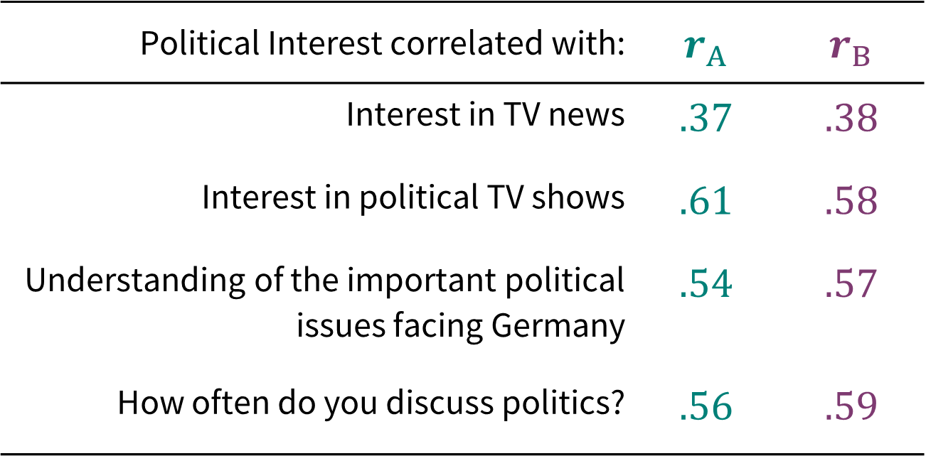
Example: Interest in Politics
A
B
Political Interest correlated with: | $r_{A}$ | $r_{B}$
Interest in TV news | .37 | .38
Interest in political TV shows | .61 | .58
Understanding of the important political issues facing Germany | .54 | .57
How often do you discuss politics? | .56 | .59
If modes A and B
work similarly,
we would expect
similar correlations
in both modes
(row-wise)
A
B
Notes:
Here a simply mock-example for political interest. Imagine we correlate it with other measures such as interest in TV news or how often respondents discuss politics with others.
It is inutitive to assume that we should get similar correlations in modes A and B if they are comparable.
However, note that this approach works best in a random mode experiment. Otherwise, the true correlations might have changed over time for example.

Slide 18
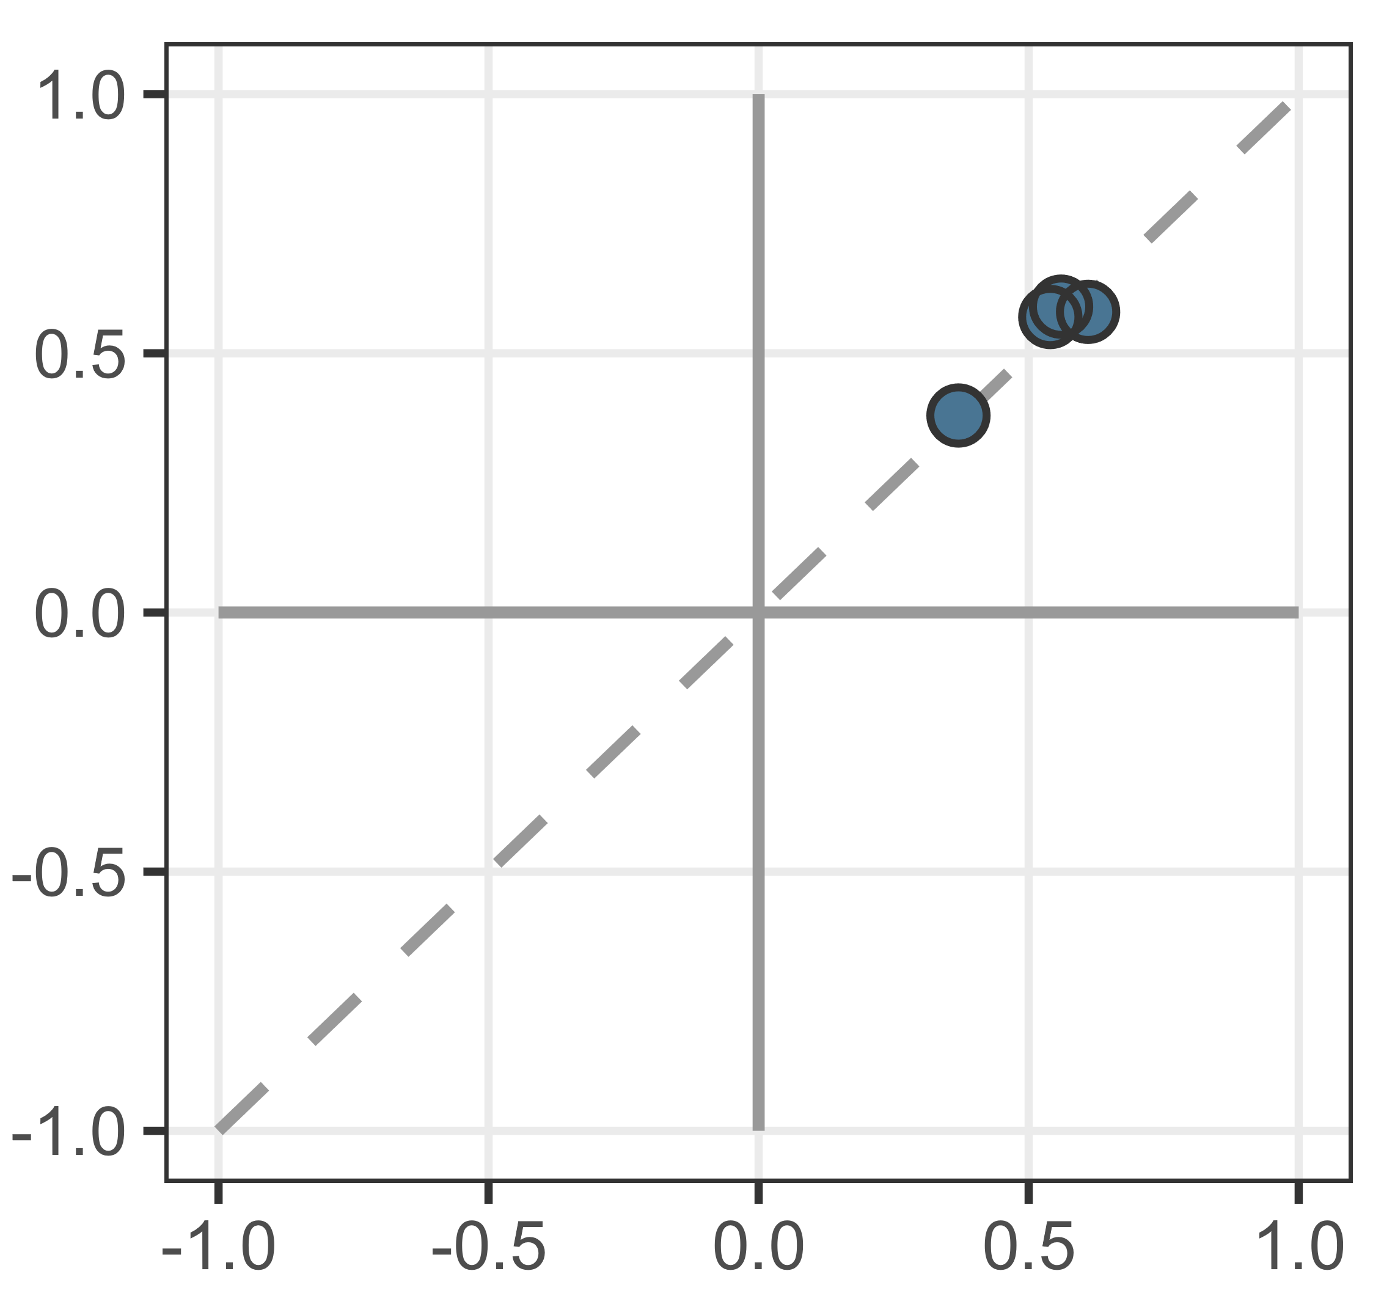
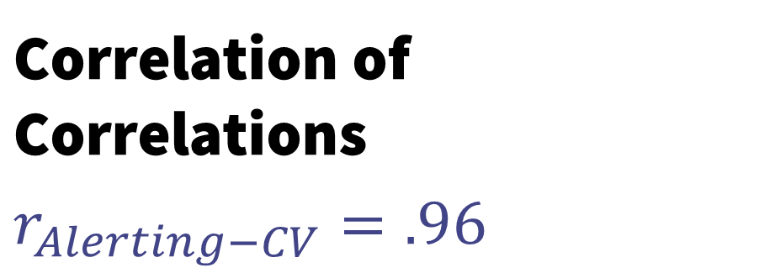
Summarising Validity Correlations
Correlation of Correlations
$$r_{Alerting−CV}=.96$$
B
e.g., „Interest in TV news“
Westen, D., & Rosenthal, R. (2003). Quantifying construct validity: Two simple measures. Journal of Personality and Social Psychology, 84(3), 608–618. https://doi.org/10.1037/0022-3514.84.3.608
A
Notes:
As a scalable approach, we can summarise these correlation pairs into a single value.
Westen and Rosenthal recommend correlating these pairs of correlations. On the left side, we see the four correlation pairs as a scatterplot and an associated correlation of correlations in modes A and B of .96.

Slide 19
Summarising Validity Correlations
The resulting scatterplot has two defining features:
The spread around the trendline (quantified by r-Alerting)
The slope of the trendline
B
A
Notes:
The overall test with all intercorrelations also has some additional interesting implications.
Imagine a massive scatterplot. And now add a linear trendline.
We can now observe a spread around the trendline quantified by r-Alerting and the slope of the trendline.

Slide 20
Comparative Attenuation
Correlation of correlations
Slopes
Low r-Alerting
Wide spread
Slope ≈ 1
High r-Alerting
Good linear fit
Slope ≈ 1
High r-Alerting
Good linear fit
Slope < 1
High r-Alerting
Good linear fit
Slope > 1
High r-Alerting (~good linear fit)
implies good conceptual comparability
However, the slope should also be close to 1!
However, good linear fit but a slope ≠ 1
might imply a global difference in random errors
between the modes!
Notes:
A high r-Alerting and thus a low spread implies good overal conceptual comparability.
However, ideally the slope should also be close to 1!
To see why that is, consider the case where the slope is steeper or flatter, yet correlations still fall close to the trendline.
This would happen, if there is a global difference in reliability across all instruments in one mode compared to the other.
Less abstractly, if one mode measures everything more precisely than the other, then the slope changes.
The slope basically points towards the axis of the more precise mode.
The mathematical reason is attenuation. If all reliabilities are lower in one mode, then all intercorrelations are reduced in that mode.
In other words, we can get a quick exploratory overview, over widespread reliability differences between the two modes via what I dub comparative attenuation.

Slide 21
Formal Measurement Invariance
MGCFA
Concepts and Reliability
R-Alerting and comparative attenuation
Aligning measurement units
OSE-RG
Aligning measurement units
OSE-RG
Generalizable Mode Effects
MTMM Meta-Analysis with SQP

Slide 22
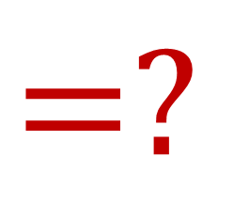


Random Groups Design (= random experiment for Equating)
TSE: Representation ✓
TSE: Measurement
A
A
$=$✓
$=$✓
$$=?$$
B
B
Equally good
Random samples in modes A and B
Identical
Latent distributions in both samples
Distribution Differences
=
Measurement Unit Differences
Notes:
Here we have the same setup, but we have either found representation errors to be the same in both modes or we have mitigated errors in representation.
If so, then we can assume that the both random samples in modes A and B result in identical latent sample distributions. In other words, identical distributions of true scores in both samples.
If the observed response distributions then still differ, it means that we have isolated a pure measurement unit difference between modes A and B.

Slide 23







OSE-RG: Observed-Score Equating in a Random Groups Design
A
A
1
2
3
4
1
2
3
4
#
$${\overline{x}}_{B}$$
$$≠$$
$${\overline{x}}_{A}$$
$${\overline{x}}_{B}$$
$$=$$
$${\overline{x}}_{A}^{∗}$$
B
B
Identical
Latent distributions in both samples
Different
Response Distributions
Align Response Distributions
with OSE-RG
Recoded mode A
now fits mode B
Notes:
Based on this, we can apply Equating. Specifically Observed Score Equating in a Random Groups Design.
This psychometric method alings measurement units so that scores measured with different instruments, or here in different modes, become comparable.
Remember, the latent distributions in both samples are now assumed to be the same.
Then if we look at different response distributions, we know that these differences are differences in measurement, not true differences.
Observed score equating then simply recodes the response scores of one instrument so that it fits the measurement units of the other instrument,

Slide 24
Linear Equating Algorithm: Recoding A to B
Response distributions
for A and B
in a random groups design
Differences in distribution shape are measurement differences, not true differences
A
1
2
3
4
B
1
2
3
4
Notes:
A quick look at an easy equating algorithm, linear equating.
We take the two response distribution in our random groups design.
We can assume that the true latent distributions are the same. The response distribution differences are differences in measurement.

Slide 25
Linear Equating Algorithm: Recoding A to B
Response distributions
for A and B
in a random groups design
…
simplified to two parameters Mean and SD
A
1
2
3
4
B
1
2
3
4
-SD
+SD
M
Notes:
Now we simplyfiy our problem by reducing the response distributions to two parameters: Their means and standard deviations.

Slide 26
Linear Equating Algorithm: Recoding A to B
Linear transformation to recode scores of A towards the measurement scale of B…
Aligning the means
A
0.6
1.6
2.6
3.6
B
1
2
3
4
-SD
+SD
M
Notes:
Then we can align the scores of mode A towards the new mode B by first shifting the scores of A so that the means are aligned.

Slide 27
Linear Equating Algorithm: Recoding A to B
Linear transformation to recode scores of A towards the measurement scale of B…
Aligning the means
and the standard deviations
A
0.3
1.4
2.8
3.9
B
1
2
3
4
-SD
+SD
-SD
+SD
M
M
Notes:
And then we stretch A so that the standard deviations are aligned as well.
Note that A now has recoded scores that fit the new measurement units of mode B.
The approach is no more complex than a simple z-standardization. The magic, so to speak, lies in the random groups design, which isolated measurement by controlling for true latent differences.

Slide 28

OSE-RG with a reference survey program (with probabilistic samples of the same population)
Two surveys randomly sampling the same country in the same year are also a random groups design!
Equating can be chained: $A→R→B$
At minimum we need only two population-time links
2000
2005
2010
2015
2020
Notes:
For some projects, however, it may not be feasible to perform a random mode experiment.
However, if we have different survey programs with random samples in a population, we can use them instead.
After all, two high quality survey programs in with waves in the same year do form a random groups design.
The key addition here is that equating can be chained. We have no time overlap of modes A and B.

Slide 29

OSE-RG with a reference survey program (with probabilistic samples of the same population)
$$A→R→B$$
2000
2005
2010
2015
2020
Notes:
However, we can harmonize our measured concept in mode A towards survey R…

Slide 30

OSE-RG with a reference survey program (with probabilistic samples of the same population)
$$A→R→B$$
2000
2005
2010
2015
2020
Notes:
…and then we can equate those transformed values towards the new mode B, thus healing the time series.

Slide 31
Observed-Score Equating in a Random Groups Design
Points to consider:
OSE-RG only aligns Measurement Units
Systematic and random measurement errors are preserved
Mode dependent errors of representation can bias the Equating Result!
Mitigating differences in representation:
Adjustment weights
NEC Equating (Non-equivalent groups with covariates design)
Notes:
To end this part, I need to stress some points.
Firstly, the approach only aligns measurement units. Systematic and random measurement errors remain unchanged and need to be adressed separately.
Secondly, different errors of representation in the two modes can bias the equating results.
Thus we should carefully examine representation differences between modes first.
If they occur, we should mitigate them. One idea are applying adjustment weights. Another is to use an equating procedure that makes use of other covariates in the data to correct for population differences.
Both approaches, however, are no guarantee of comparable representation. Unobserved heterogeneity, that is representation errors in hidden respondent characteristics remain untouched by these methods.

Slide 32
Formal Measurement Invariance
MGCFA
Concepts and Reliability
R-Alerting and comparative attenuation
Aligning measurement units
OSE-RG
Aligning measurement units
OSE-RG
Generalizable Mode Effects
MTMM Meta-Analysis with SQP

Slide 33

Primer on the
MTMM Experiments evaluating the measurement quality of >6000 instruments in 33 countries
Coding
a set of
formal design
characteristics
Meta-Analysis
predicting
measurement quality
via these characteristics
ESS
Notes:
What is he SQP?
In short, the SQP is based on a large pool of methodological multi-trait-multi-method experiments. Those experiments, many of which were conducted in the context of the ESS by the way, result in quality estimates for more than 6000 survey instruments across 33 countries.
Then those instruments were coded regarding about 40 formal design characteristics, such as number of scale points, lenght of introduction and so on.
Then a meta-analyses was conducted which predicts measurement quality based on the interplay of these characteristics.

Slide 34

SQP for users
?
Coding the formal characteristics of a question to be evaluated
SQP
determines the likely quality based on the meta-analysis
Quality estimates
are given as point estimates with ranges
Notes:
Users can now access these results by coding their own, newly developed instruments. Based on the forma characteristics, the SQP website extracts a quality estiamte and a range of probably qualities from the meta-analysis.
This is not as good as performing your very on MTMM experiment for each instrument, but it gives a general idea how similarly designed instruments fared in terms of quality.
The quality range also illustrate how well we can predict quality based on these characteristics.

Slide 35
SQP in survey mode harmonization
SQP has several characteristics of interest for survey mode harmonization!
Showcards or other visual aid used?
Horizontal or vertical scale?
…
Computer assisted answer registration?
Interviewer or self-completion?
Visual or oral presentation?
Notes:
Now with regard to survey modes, the interesting aspect is that the SQP does contain several characteristics of interest for survey mode harmonization.
For example if visual aids were used and if so if the scales were horizontal or vertical. Many surveys are now switching from horizontal showcards in interviews to vertical response scales optimized for web surveys on smarphones.
Other characteristics focus on computer assistance, interiewer presense, as well as visual or oral question presentation.

Slide 36
SQP in survey mode harmonization
Quality Estimates
Predicting the quality of indivisual questions in both modes
Generalizable Effects?
Querying the meta-analysis for general effects of mode relevant charateristics
Meta-Analytical Framework
Adding new MTMM-Mode Experiments to the SQP Pool
Notes:
To my mind, we could explore using the SQP for mode comparability in three ways.
Firstly, by simply inputting questions with different mode characteristics and lookign at the predicted quality differences. This at least gives us an idea how much such mode characteristics changed measurement quality on average in other instruments.
Second, we could look at the meta-analysis itself and try to extract general estimates for the relevant characteristics. Does horizontal versus vertical orientation matter overall? Or just in very long response scales? Barbara Felderer, who spearheads the revised SQP meta-analysis at GESIS is open for research cooperations, if this interests you.
Third, as more and more survey programs plan mode changes and perform experiments on them, we might design some of these experiments as MTMM experiments and add them to the SQP pool. The meta-analytic framework might be helpful and newly gathered data could be enriched and contrasted with the existing results.

Slide 37
A
B
Notes:
Lastly, I want to remind you that yes, the challenges are many and also quite complex.
However, there are many approaches to assess comparability. The four examples in my talk barely scratch the surface here.
Also, as we have seen, we are not limited to just assessing the damage. We can also mitigate some comparability issues after the data has already been collected.
Think of alinging measurement units with equating. Or when reliabilities differ, we can perform corrections for attenuation to reduce the bias in our analyses.

Slide 38
Generalizability across…?
?
Specific Questions
Modes may have very different effects on different instruments
Countries / Cultures
Modes may have different effects in different countries / cultures / languages
Respondents
Specific respondents or specific suppopulations may react differently to different modes
However, searching for generalizable methodological differences between modes is still important!
Notes:
As a last point on survey mode harmonization in general, I want to raise the issue of generalizability of survey mode findings.
At this point, it is not yet clear if mode effects can be generalized across many settings.
Mode effects could affect different survey questions differently. Complex socio-structural questions might suffer more in self-andiminstrated modes than simple opinion questions for example.
Mode effects might also differ between countries and cultures. People in Japan might adapt to websurveys more easily than the sometimes technophobic Germans.
And lastly, different respondents or respondent groups might react differently to different modes. Privacy conscious respondents might shun web surveys, for example.
While much research has already been done on mode effects, I expect that the quasi-experiments forced by the corona pandemic as well as the current efforts of many surveys to switch to self-completed modes will result in a wealth of experimental data. I remain omptimistic that we can find and corroborate at least some persistent, generalizable mode effects. Such findings would greatly reduce the effort for future mode change efforts.

Slide 39
Healthy Pragmatism
Modes can matter, but they do not have to matter
Comparability brings methodological issues into sharp contrast. However, we should not be stricter in comparability than we are in single-mode data
Quantifying issues is often all it takes to mitigate issues

Slide 40
Ressources
GESIS Blog Series on (Instrument) Harmonization https://blog.gesis.org/adventures-in-ex-post-harmonization-frankensteins-creature/
SQP 3.0
https://sqp.gesis.org/
GESIS consultation on harmonization
https://www.gesis.org/en/services/crm/request-form-for-consultations-and-scientific-services
Singh, R. K. (in print). Harmonizing single-question instruments for latent constructs with equating using political interest as an example. Survey Research Methods

Slide 41
Thank you for your attention!

